Slide 1

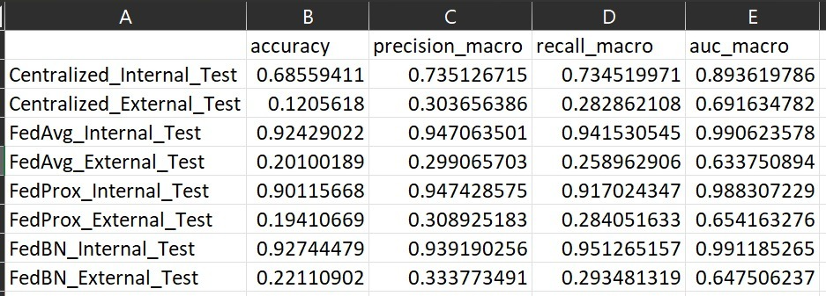
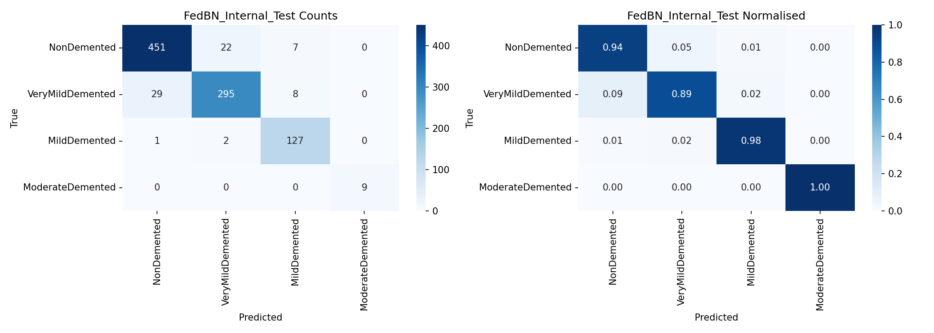
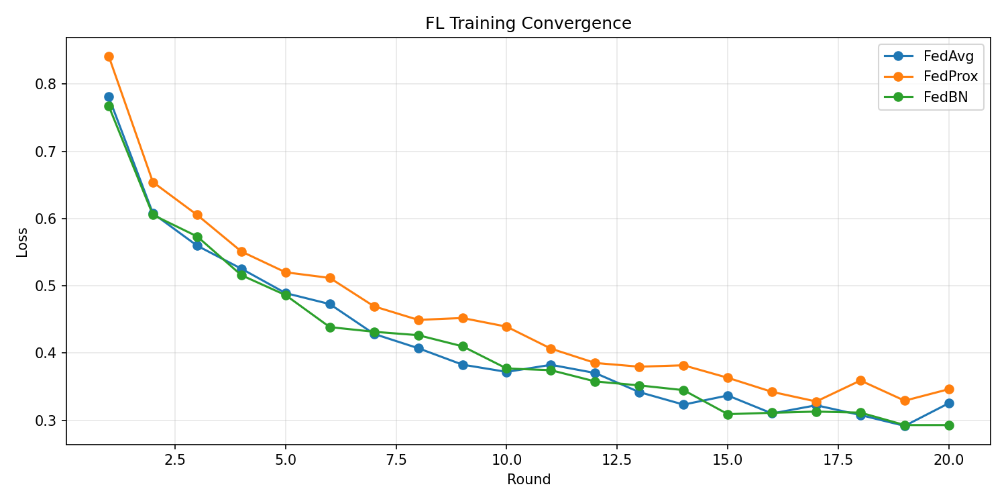
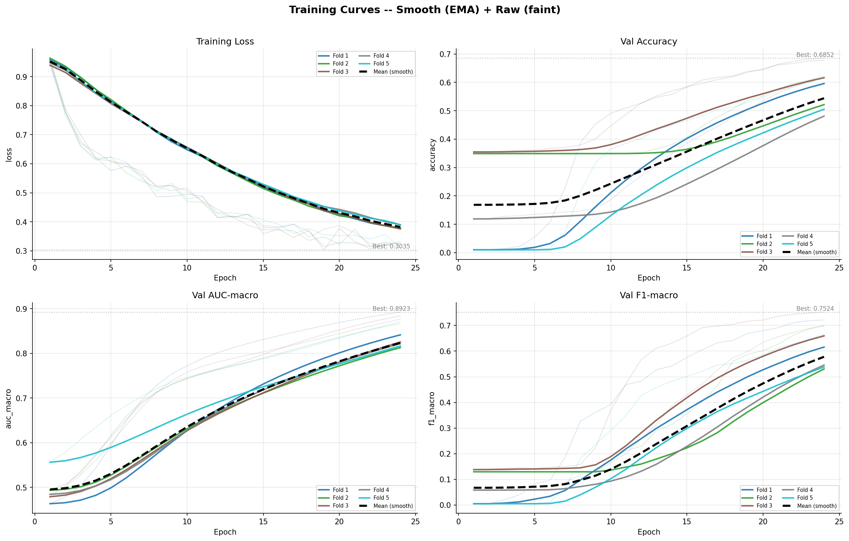
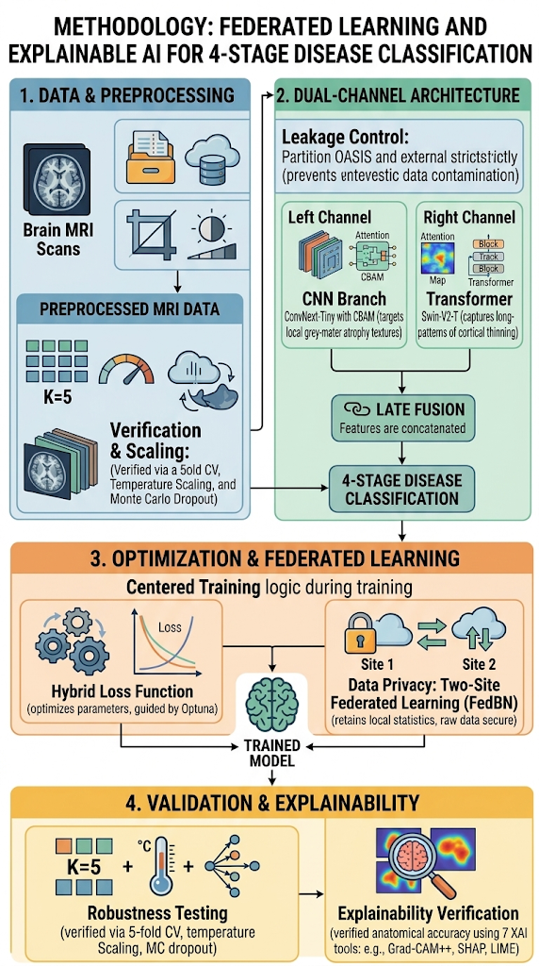
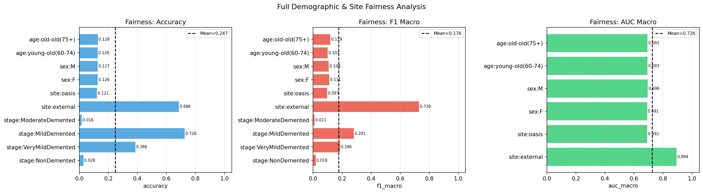
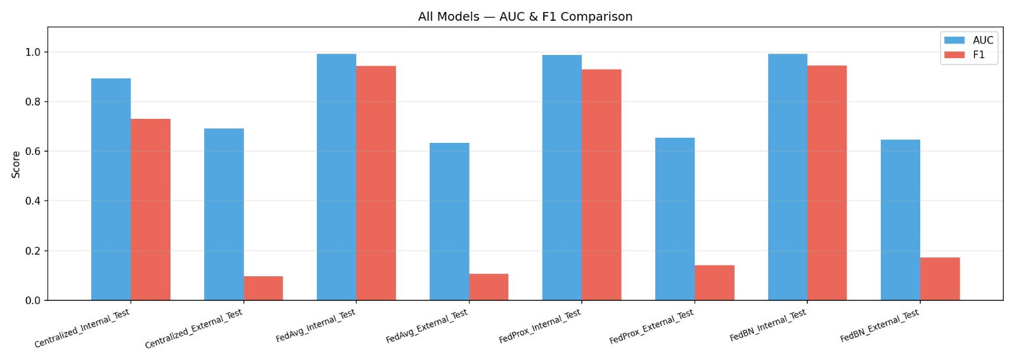
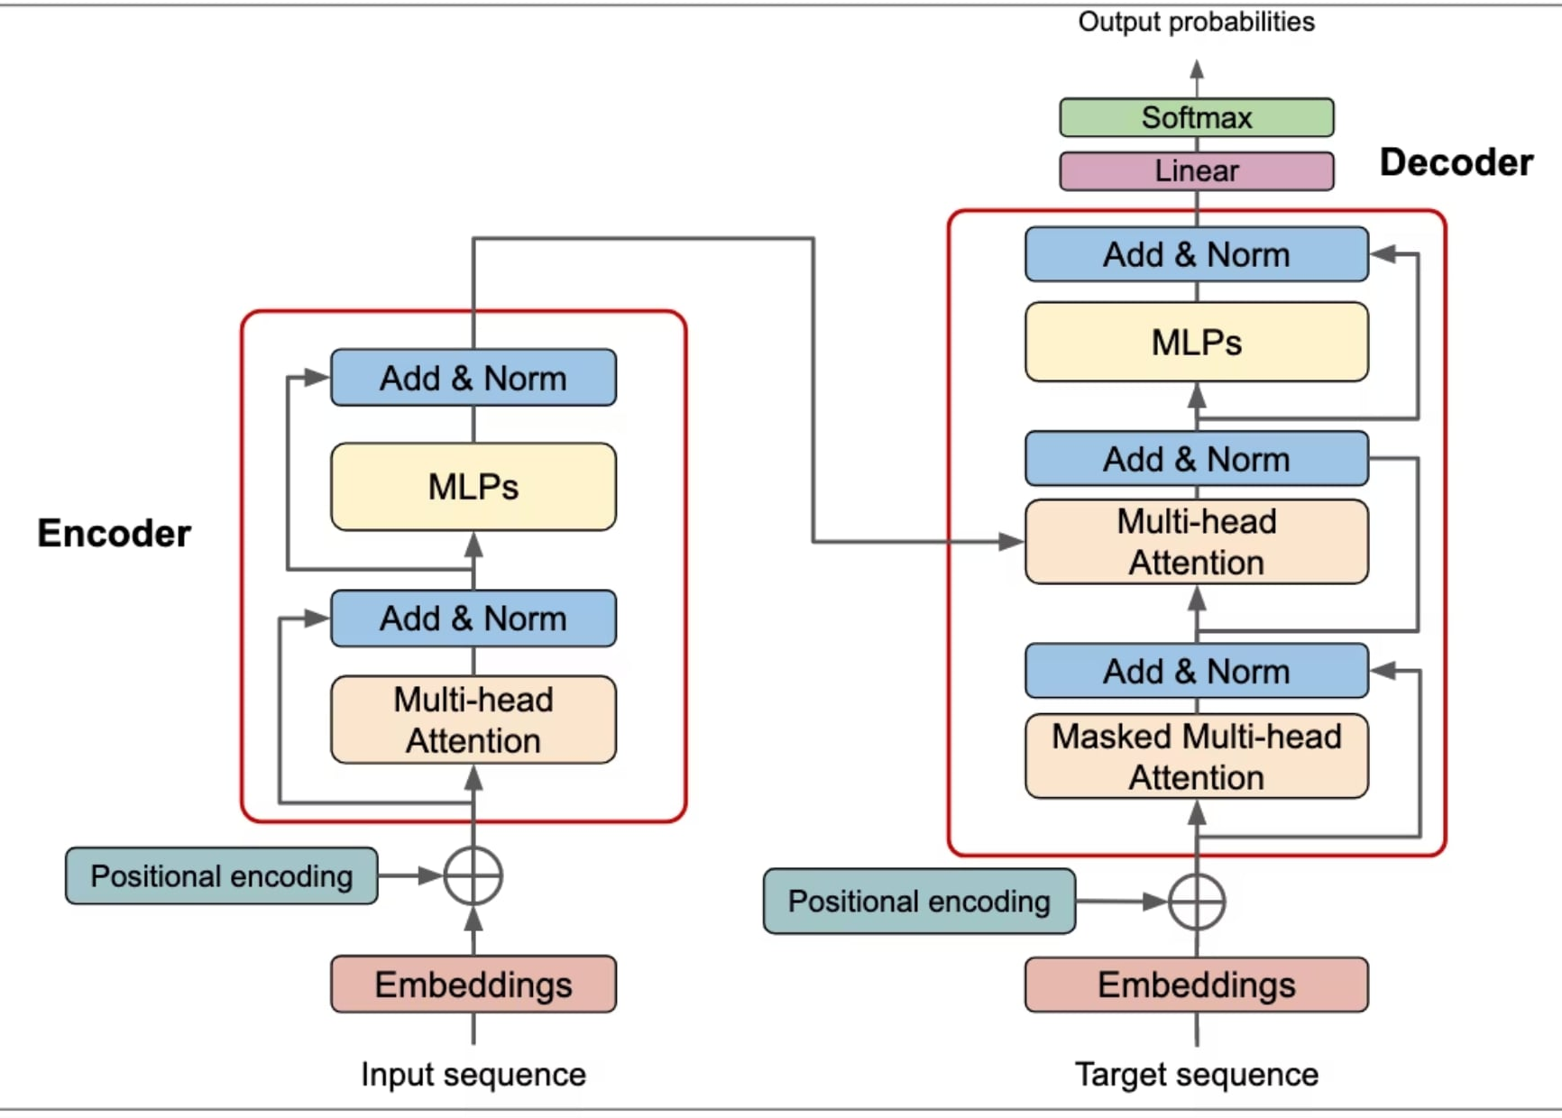
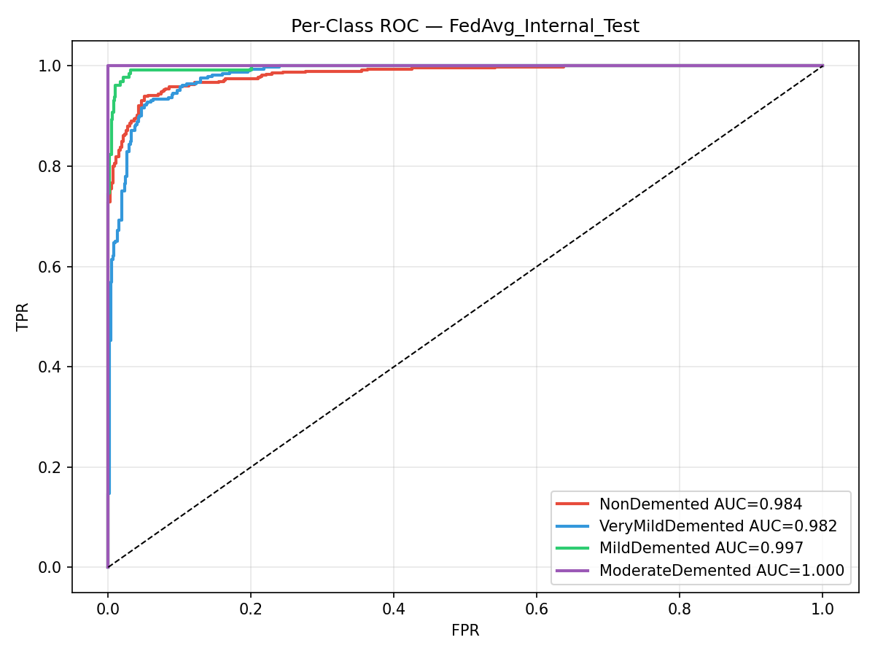
Explainable Federated Deep learning for Alzheimer's Disease Detection
Hamidul Islam (23-50447-1), Md. Shamsul Islam (23-50735-1), Abtahi Islam (23-50434-1), Md. Hasibul Islam (23-50434-1)
Abstract
The clinical adoption of deep learning for Alzheimer’s disease (AD) detection via structural MRI is currently limited by patient data privacy concerns and the opaque nature of neural networks. To overcome these barriers, we introduce a secure, dual-channel hybrid architecture combining a Convolutional Neural Network (ConvNeXt-Tiny) to detect localized grey-matter atrophy and a Vision Transformer (Swin-V2-T) to model global patterns of cortical thinning. We trained the framework across multiple sites using Federated Batch Normalization (FedBN) to handle non-IID clinical data distributions without exchanging raw patient scans. Our FedBN approach vastly outperformed centralized training on internal testing, elevating diagnostic accuracy from 68.56% to a peak of 92.74% (AUC: 0.991). However, significant performance degradation during external evaluation (22.11% accuracy) highlighted the profound impact of multi-site domain shift, underscoring the necessity of advanced data harmonization methods like ComBat for real-world generalization. Validated by a rigorous suite of Explainable AI (XAI) tools that ground predictions in established anatomical biomarkers, this framework establishes a highly accurate, privacy-preserving, and transparent pathway toward the trustworthy clinical deployment of automated AD screening.
Index: Alzheimer's Disease, Federated Learning, Explainable AI, Hybrid Architecture, Domain Shift.
Result Analysis
Fig 7: Performance Comparison of Centralized and Federated Learning Models on
Internal and External Test Sets
Fig 1: FedBN confusion matrix on internal test set
Accuracy=92.7%, MCC=0.881. Near-perfect classification for NonDemented (94%) and MildDemented (98%). ModerateDemented fully captured (100%). Normalized and count views shown.
Internal and external performance of centralized, FedAvg, FedProx, and FedBN models. Federated models achieved strong internal performance, with FedBN reaching 92.74% accuracy, but performance declined substantially on the external dataset because of severe domain shift.
Analysis: The evaluation highlights the significant superiority of the proposed federated approach over traditional centralized training. Specifically, our FedBN framework achieved peak performance with 92.74% accuracy and a 0.9912 AUC, vastly outperforming the centralized baseline's 68.56% accuracy. This demonstrates that retaining local normalization statistics successfully mitigates the challenges of non-IID clinical data while strictly preserving patient privacy.
Introduction
Alzheimer’s disease (AD) is a rapidly growing global health crisis. While deep learning on structural MRI enables highly accurate early detection, clinical adoption is currently blocked by two major hurdles: patient data privacy risks and untrustworthy “black-box” models.
To address these challenges, we introduce a novel hybrid CNN-Transformer framework designed for secure, transparent, and accurate AD screening. Our approach features:
Dual-Channel Architecture: Combines CNNs and Transformers to capture both local tissue degradation and global brain patterns.
Federated Learning: Trains collaboratively across multiple hospitals without ever sharing sensitive raw patient data.
Explainable AI (XAI): Generates anatomically precise, visually grounded maps of key AD biomarkers (like hippocampal shrinkage), delivering a highly accurate diagnostic tool that clinicians can actually
trust.
Discussion
Overcoming Domain Shift: The proposed federated approach (FedBN) vastly outperformed the centralized model, elevating diagnostic accuracy from 68.56% to a robust 92.74%. This confirms that retaining local normalization statistics successfully mitigates the severe data distribution disparities typically found across different clinical sites.
Clinical Viability & Privacy: By training collaboratively across multiple institutions without ever exchanging raw MRI scans, the framework completely resolves critical patient data privacy bottlenecks while maintaining peak diagnostic performance.
Trust Through Transparency: The hybrid CNN-Transformer architecture, validated by a rigorous suite of XAI methods, ensures that model predictions are driven by genuine anatomical biomarkers (like cortical thinning) rather than background noise. This bridges the gap between opaque deep learning models and trustworthy clinical application.
Fig 2: Convergence of FedAvg, FedProx, and FedBN across federated communication rounds.
FedBN demonstrates fastest convergence and highest terminal performance due to site-specific batch normalization.
Methodology
Fig 3: 5-fold CV training dynamics of DualAttenADNet with EMA smoothing.
Peak metrics : Val AUC-macro: 0.892 | Val F1-macro: 0.752 | Val Accuracy: 0.685. Stable convergence across all folds confirms model robustness.
Conclusion
The dual-channel CNN-Transformer model using federated learning achieves highly accurate, privacy-preserving Alzheimer's screening on internal data. However, its poor performance on external datasets reveals a significant domain shift issue, meaning advanced data harmonization is essential before this explainable AI can be reliably deployed in clinical settings.
Fig 4: Fairness audit across age (young-old 60–74 / old-old 75+), sex (M/F),
site (OASIS/external), and disease stage subgroups.
Equitable accuracy and AUC across sex and age groups (Δ<0.003) confirms minimal demographic bias in DualAttenADNet.
Reference:
[1] Abdelwahab, M. M., Al-Karawi, K. A., & Semary, H. E. (2023). Deep learning-based prediction of alzheimer’s disease using microarray gene expression data. Biomedicines, 11, 3304.
[2] Abubakr, N., Kara, M., & Balık, H. H. (2026). Explainable federated attention-based deep learning for alzheimer’s disease detection. Applied Sciences, 16, 4648.
[3] Akindele, R. G., Adebayo, S., Yu, M., & Kanda, P. S. (2026). Alzhinet: Traversing from 2d-cnn to 3d-cnn, towards early detection and diagnosis of alzheimer’s disease. Interdisciplinary Sciences: Computational Life Sciences, 18, 267–284.
[4] Al Olaimat, M., Martinez, J., Saeed, F., Bozdag, S., & Initiative, A. D. N. (2023). Ppad: a deep learning architecture to predict progression of alzheimer’s disease. Bioinformatics, 39, i149–i157.
[5] Alsubaie, M. G., Luo, S., & Shaukat, K. (2024). Alzheimer’s disease detection using deep learning on neuroimaging: a systematic review. Machine Learning and Knowledge Extraction, 6, 464–505.
[6] Alsubaie, M. G., Luo, S., Shaukat, K., & Zhang, W. (2026). A novel alzheimer’s disease classification framework integrating 3d cnn with bidirectional feature pyramid network and vision transformers. IEEE Access.
Architecture Diagram
Fig 5: Comparative AUC and F1-macro scores across all strategies
(Centralized, FedAvg, FedProx, FedBN) on internal and external test sets.
FedBN achieves best internal AUC=0.991, F1=0.945. External generalization gap highlights domain shift challenge.
Fig 6: FedAvg Internal Text
Department of Computer Science, Faculty of Science and Technology.
American International University-Bangladesh (AIUB)

